Slide 1
Customer Data Analysis
SQL

Slide 2
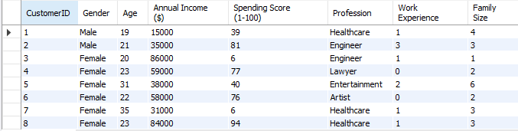
Q1. Retrieve all customer details

Slide 3
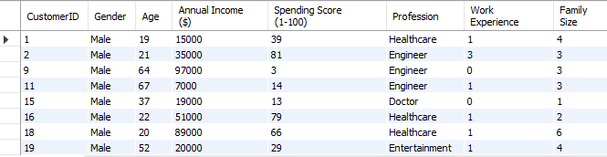
Q2. Find the details of all male customers.

Slide 4
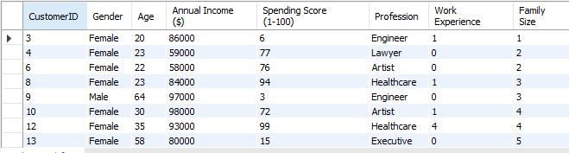
Q3. List customers who have an annual income greater than $50,000.

Slide 5

Q4. Retrieve the names and ages of customers with a family size of 4 or more.

Slide 6
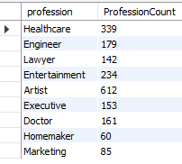
Q5. Count the number of customers in each profession.

Slide 7

Q6. Find the average spending score for customers with less than 2 years of work experience.

Slide 8

Q7. Identify the youngest and oldest customers for each gender.

Slide 9
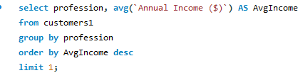

Q8. Find the profession with the highest average annual income.

Slide 10

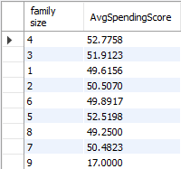
Q9. Determine the correlation between family size and spending score.

Slide 11
Retrieve customers whose spending score is in the top 10%.

Slide 12
Thank You

